Slide 1
Voltage Round Robin
Status Update
An OSU/HR Study
Prepared by: Brian Johnson, Colleen Chlastawa, Yaw Agyei and Yonas Behboud of The Boeing Company
Presented by: Yonas Behboud, October 2019 FTWG

Slide 2
Background and Round Robin Purpose
Prior Presentations
  Voltage vs Heat Flux Study (Presented June 2017)
  Effects of Heat Flux on Heat Release (Presented November 2017)
  Voltage Round Robin (Presented June 2018)
  Voltage Round Robin Status Update (Presented October 2018)
  Round Robin Purpose
  Record the supply voltage and ambient load variations of FTWG labs operating OSU heat release rate units
  Use the results to understand supply voltage variation to assess needs for power conditioning
  Evaluate the variation and power conditioning solutions to determine HR2 specification criteria and OSU test method guidelines

Slide 3

Round Robin Participation
22 Labs
  13 Domestic (USA)
  Jamco-America
  General Plastics
  Zodiac Heath Tecna
  Krueger Testing & Consulting
  Element Materials & Technology
  HAECO Americas Cabin Solutions
  AccuFleet Testing Services
  Skandia
  SEKISUI SPI
  Schneller
  Herb Curry Inc.
  SGS Govmark
  TESTCORP
  9 International
  CTA (Centro de Tecnologias Aeronauticas)
  CSIR, MSM, Nonwovens & Composites Laboratory
  Jamco Singapore Pte Ltd
  AIRBUS
  Zodiac Aerospace (SELL)
  RESCOLL
  DGA Techniques Aeronautiques
  Test Center of Civil Aviation Administration of China (CAAC)
  F. List
Notes:
Performance improvement must justify investment in new equipment

Slide 4
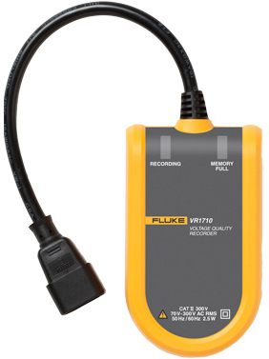
Round Robin Procedure
    Fluke Model VR170 Voltage recorder supplied by Boeing
    Voltage recorder connected to unit power supply for 10 days
    Recorders returned to Boeing for data extraction, compilation, and analysis
    Preliminary results shared with FTWG
      October 2018 preliminary results
      Full results will be provided to participants

Slide 5
Round Robin Questionnaire Results
Questionnaire sent to each participant with the logger
  Results displayed in percent of participants
Question | Yes | No
Presence of power conditioning? | 0% | 100%
Lab adjacent to any manufacturing facility? | 43% | 43%
Have you ever experienced difficulties calibrating heat flux density | 29% | 71%
Do you typically need to adjust power settings to the heaters during calibration? | 29% | 71%

Slide 6
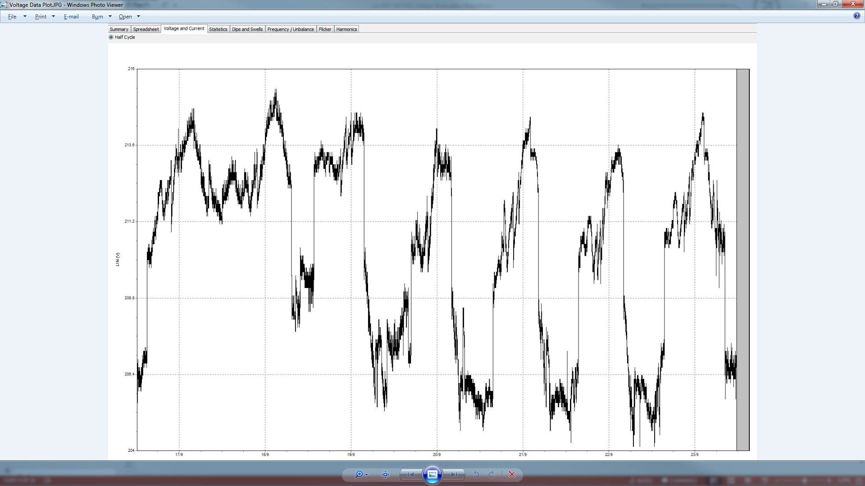
Graphical Representation of Voltage Recorder Results
216.0
OSU On
OSU Off
213.6
211.2
Volts
208.8
206.4
204.0
Fri
Sat
Sun
Mon
Tue
Wed
Thu
Fri

Slide 7
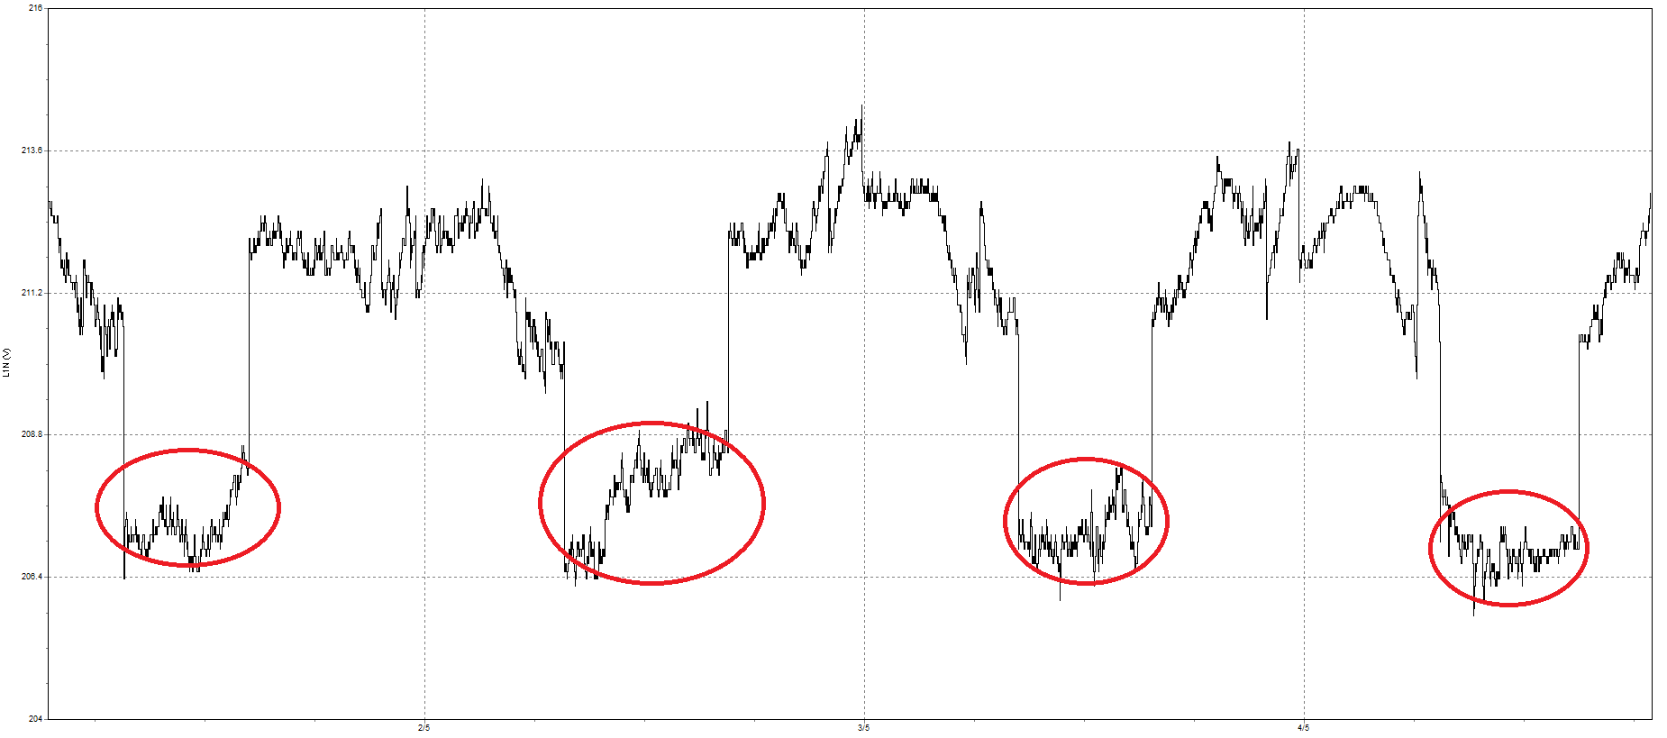
Analysis of Round Robin Data – Voltage Range
95% Tolerance Interval Method
  Using the “On” voltage data during times where the globars were powered
  Applied a 95% tolerance method to exclude outliers that represent less than 5% of the total “On” data
What does this mean?
“We have a 95% confidence that 95% of the data lies between the upper and lower voltage interval limits.”

Slide 8
Assumptions of Round Robin Data
The data outside of the 95% tolerance interval represents a small portion of the population and does not significantly impact heat flux.
Voltage ranges observed during the monitoring period are representative of normal operation.
208V supply cannot exceed ±1.5V (3V range) in order to maintain a 3.5 W/cm² ± 0.05 calibration range if calibrated at exactly 3.5 W/cm² (presented June 2017, Boeing Everett OSU).

Slide 9
Example of 95% Tolerance Interval (TI) Analysis
95% TI Range = 4.1 Volts

Slide 10
*Lab only included a 2 hour period of time where the OSU was turned on
**Lab voltage was in the 120V range compared to 208V or 240V

Slide 11
*Lab only included a 2 hour period of time where the OSU was turned on
**Lab voltage was in the 120V range compared to 208V or 240V

Slide 12
Preliminary Observations
Reiterating 3rd Assumption
  208V supply cannot exceed ±1.5V (3V range) in order to maintain a 3.5 W/cm² ± 0.05 calibration range if calibrated at exactly 3.5 W/cm² (presented June 2017, Boeing Everett OSU).
  Assuming other OSU units have an equivalent relationship between voltage and heat flux, observations to date may indicate a benefit for voltage conditioning industry-wide

Slide 13
Future Actions
  Analyze and distribute data to participating labs
  Use data to generate test cases for power conditioner evaluation
  Assess power conditioner performance using test cases
  Optimize power conditioner designs
  Re-asses specification controls
    1% limit sufficient? Time basis may need to be added
    Balance specification with power conditioner capability

Slide 14
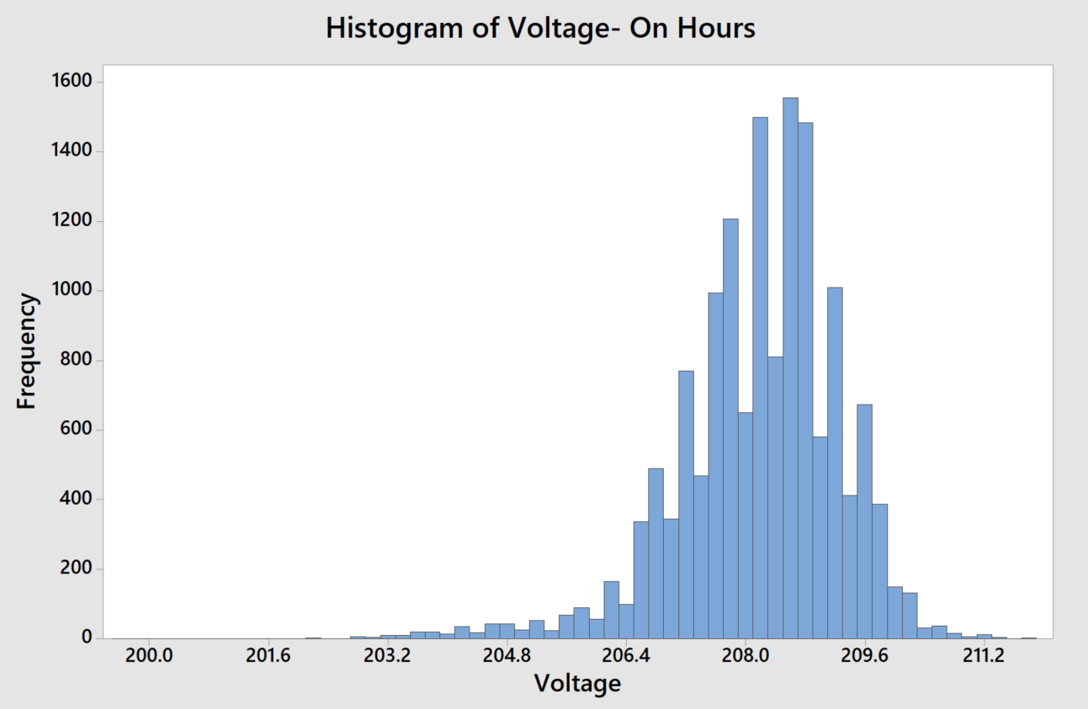
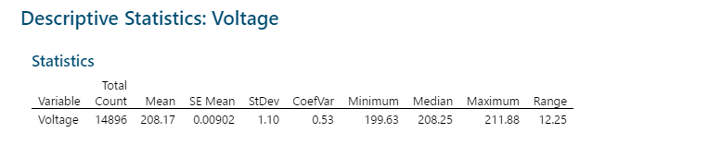
Sneak Peek - Individual Lab Report Contents
Voltage - Business Hours (Unit on) - Histogram and Descriptive Statistics

Slide 15
Analysis - Results
Sneak Peek - Individual Lab Report Contents
Visual of ranges
Voltage Mean (208.17V)
95% Percentile Range
“ON” hours full range
All recorded hours full range
192.88 V
217.50 V

Slide 16
Analysis - Interpretation
Sneak Peek - Individual Lab Report Contents
Visual of ranges
Voltage Mean (208.17 V)
Boeing Suggested Range
Boeing suggests 3V range based on voltage¹, heat flux density and heat release rate measurements studies². 3V range fluctuations will not force heat flux density out of specified range if initially calibrated at 3.5 W/cm².
FAA Proposed Range
95% Percentile Range
“ON” hours full range
All recorded hours full range
192.88 V
217.50 V

Slide 17
Conclusion
Sneak Peek - Individual Lab Report Contents
Analysis shows 95% of measured voltage distribution falls between 205.6 –210.0V.
FAA proposed tolerance of +/-1% limits voltage fluctuations between 206.1–210.3V. There is about a 6% probability electrical supply voltage falls out of tolerance.
Based on Boeing study^{1,2}, supply voltages should be controlled between 206.67 - 209.67 V to limit significant impact on heat flux density and heat release measurements. There is about a 14% probability that voltages fall out of recommended range and force heat flux density out of specification.

Slide 18
References
Sneak Peek - Individual Lab Report Contents
  OSU / HR 2 Heat Flux and Voltage Study
      Presented by Yaw Agyei on June 2017 at FTWG
      Prepared by Yaw Agyei, Yonas Behboud, Brian Johnson, Thomas Little of The Boeing Company
      https://www.fire.tc.faa.gov/pdf/materials/June17Meeting/Boeing-0617-VoltageFluctions.pdf
  Effects of Heat Flux on Heat Release Peak, Total, and Peak Time
      Presented by Yonas Behboud and Brian Johnson on November 2017 at FTWG
      Contributors: Yaw Agyei, Thomas Little, Theodoros Spanos, Clarence Lutz, Bill Mountain
      https://www.fire.tc.faa.gov/pdf/materials/Oct17Meeting/Behboud-1017-EffectHeat%20FluxHRResults.pdf
  Aircraft Materials Fire Test Handbook Revision 3 Chapter 4
      Test Method to Determine Heat Release Rates (HR2), Section A4.4.2.1 Radiation Source
      Drafted by Mike Burns, FAA Technical Center
      https://www.fire.tc.faa.gov/pdf/TC17-55.pdf

Slide 19
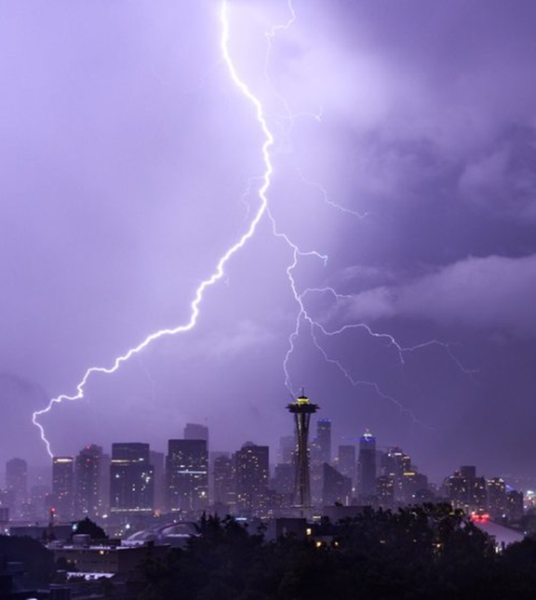
Thank you for your time
Questions?

